Slide 1
LL5532X
Did Victorian Courts Treat
Male-on-Female Cases Differently?
A legal reading of 6,945 Old Bailey guilty verdicts
After Conditioning on observable guilty cases, does a male-defendant/female-victim case configuration causally affect sentence severity?
Kalyani Pakhale

Slide 2
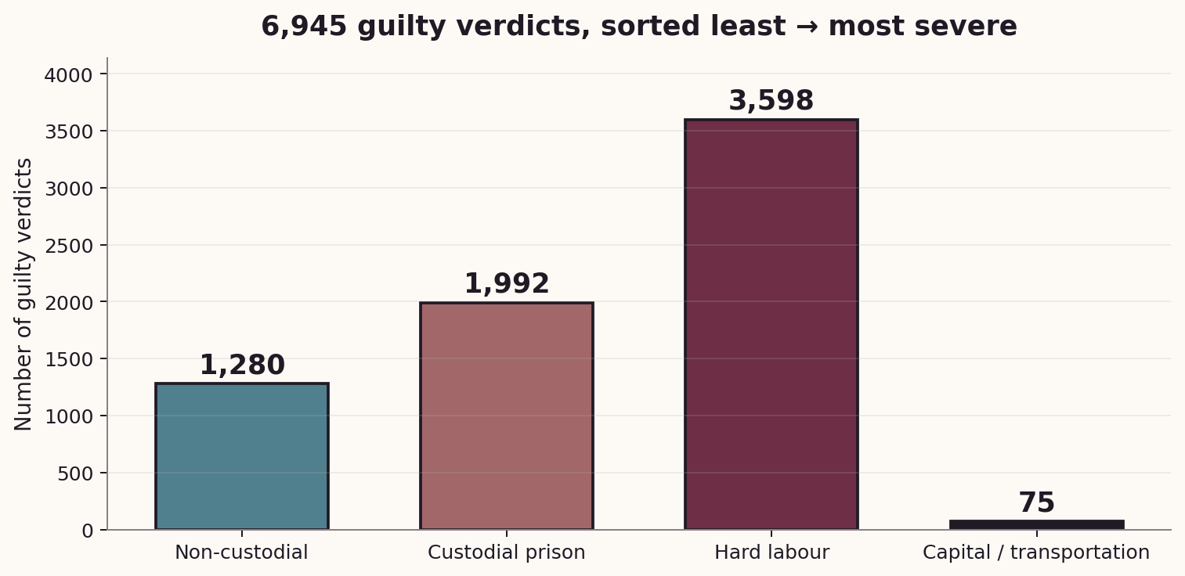
THE BASELINE
What sentences did these courts hand down?
Over half of guilty verdicts ended in hard labour. Non-custodial and capital sentences were the outliers at either extreme.
The corpus covers 6,945 guilty verdicts from the old bailey online, encoded with nlp-derived features (POS counts, named-entity counts, sentiment polarity, readability indices, 10-topic LDA probabilities) alongside structured flags for defendant and victim gender. Sentence severity is encoded on a four-level ordinal scale: non-custodial, custodial, hard-labour, capital/transportation.

Slide 3
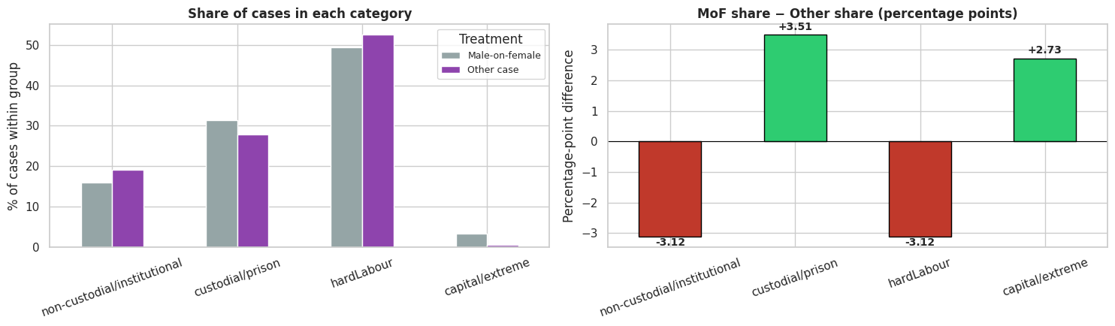
Did the two groups get different sentences?
On the corrected severity rank, male‑on‑female cases are on average +0.05 severity units harsher than other cases — a small positive gap.
On the binary "hard labour or capital" flag, the raw gap is essentially zero (−0.004). Whether a case ended up in the severe band is basically unchanged by the treatment.
A U-shaped shift
Fewer male-on-female cases ended at the lightest or middle tiers.
More ended in ordinary prison — and dramatically more in capital or transportation.
Capital rate:
3.19% (MoF) vs 0.46% (other)
= 7× relative rate
The sentencing mix differs. But is this a judicial pattern — or just different crimes?
The analysis reported that male‑on‑female cases received "lighter" sentences. That conclusion is reversed once severity is ordered correctly.
What is actually happening in the raw data is that male‑on‑female cases are substantially over‑represented in capital / transportation sentencing — a far more legally consequential finding than a small ordinal shift.

Slide 4
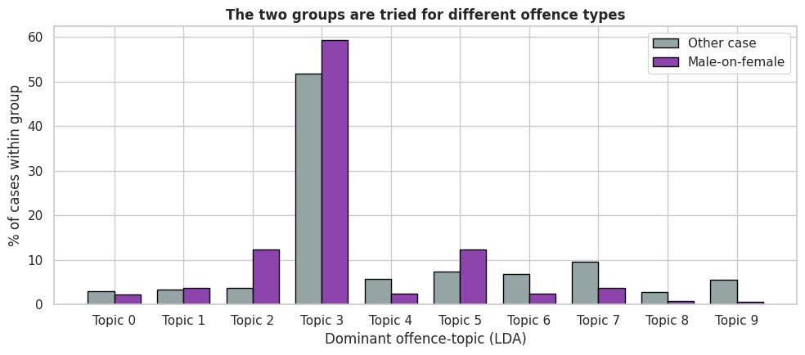
Can we trust these raw numbers as evidence of how courts behaved?
The groups aren't comparable
Male-on-female cases cluster in assault and sexual offences.
The rest of the corpus is full of forgery, coining, and large-scale theft — crimes carrying transportation tariffs by statute.
We are not comparing like for like.
The offence-topic mix is clearly different between the two groups. Some topics are heavily populated by male-on-female cases; others are almost entirely male-on-male or non-gender-coded offences.
The raw sevenfold capital-rate gap and the per-category U-shape could both be manufactured by offence-mix alone. For example, if sexual offences (a topic heavily male-on-female) carried statutory capital eligibility while coining (a topic heavily non-MoF) did not, we would see a capital-rate spike for MoF cases that has nothing to do with how judges treated male-on-female cases given a comparable offence.
Any legal claim from raw differences is unsafe. We must compare cases that are alike on everything except the treatment.

Slide 5
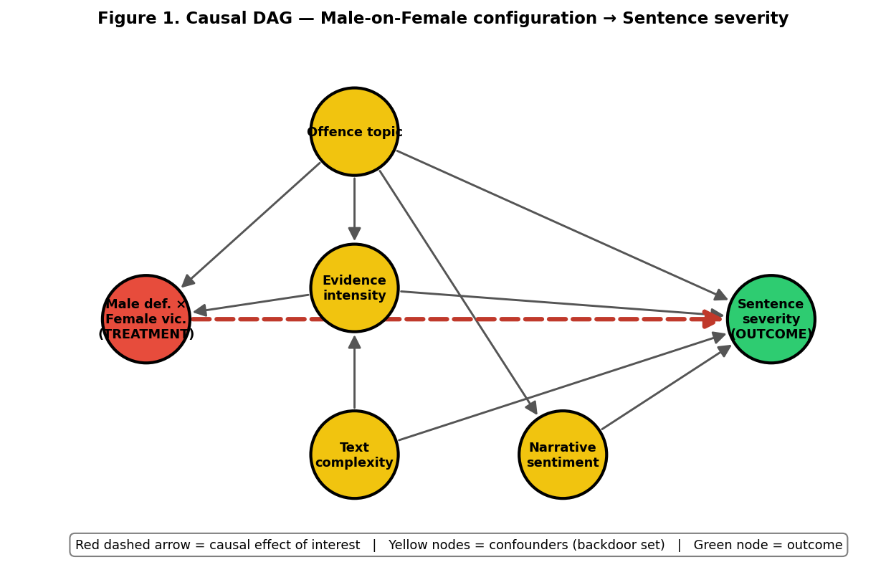
How do we compare like with like?
What we control for
Offence topic (10 LDA categories)
Evidence intensity
Narrative sentiment
Text complexity / readability
What we cannot see
Judge identity
Defendant's prior record
Plea bargaining
Legal representation
The confounder set encodes our domain knowledge: we believe offence type, evidentiary density, narrative framing, and procedural complexity are the legitimate case features that should drive sentence severity. If a treatment effect survives conditioning on this set, it cannot be explained by differences in these features.
Five independent statistical methods ask the same causal question. When they agree, we believe the finding.

Slide 6
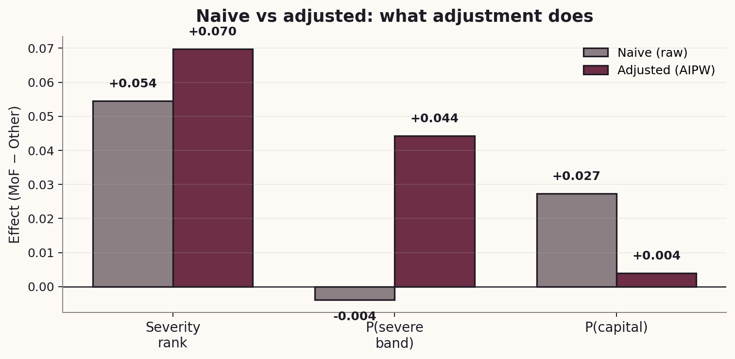
What happens when we adjust for those differences?
Q5
Adjustment reveals a hidden effect
On the severity-band outcome, the raw gap was essentially zero (−0.4%)
After adjustment, the gap grows to +4.4 percentage points.
Offence mix was masking a real effect, not inflating one.
Controlling for offence mix does not erase the pattern — it clarifies it. Male-on-female cases are harsher on every adjusted outcome.
We assembled 19 confounders — the 10 LDA topic probabilities, 6 entity-count features, and 3 readability and sentiment variables and standardised them. The defendant and victim gender flags are not in the confounder matrix because they are the components of the treatment. Conditioning on them would literally erase the treatment variation.
This is the opposite of what we might naively expect. If the raw gap were purely driven by confounders, adjusting for them should pull
the estimate toward zero. Instead, adjustment amplifies the effect. This is because offence-mix confounding was partially masking the causal signal: male-on-female cases happen to concentrate in some offence types that carry statutorily lighter sentences on average (e.g. many assaults), while the treatment effect within offence categories pushes severity up. The two forces partially cancelled in the raw data. Adjustment reveals the underlying causal effect.

Slide 7
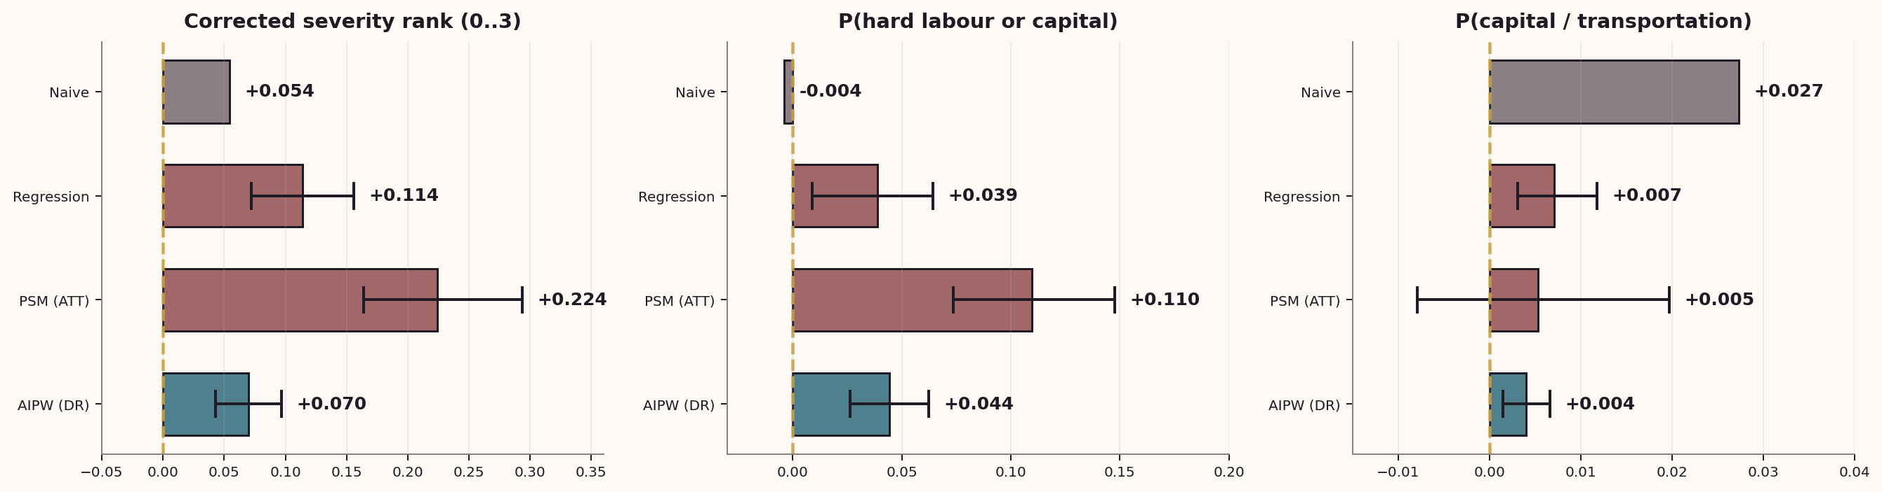
How big is the effect, and where does it live?
Three panels, one per outcome. The left-hand "corrected severity" panel shows a consistent small positive effect across all adjusted
estimators. The middle "broad severe" panel shows effects clustered near zero. The right "capital" panel shows a clear, consistent, positive effect that survives every adjustment and has confidence intervals clear of zero in most cases.
This is the single figure to put in front of a legal audience. It answers three different legal questions at once, makes the direction of each answer visually immediate, and shows that the capital-outcome finding is the best-evidenced causal claim the corpus supports.
Three different legal questions — three answers. The middle one is the clearest and largest: crossing into the severe band.

Slide 8
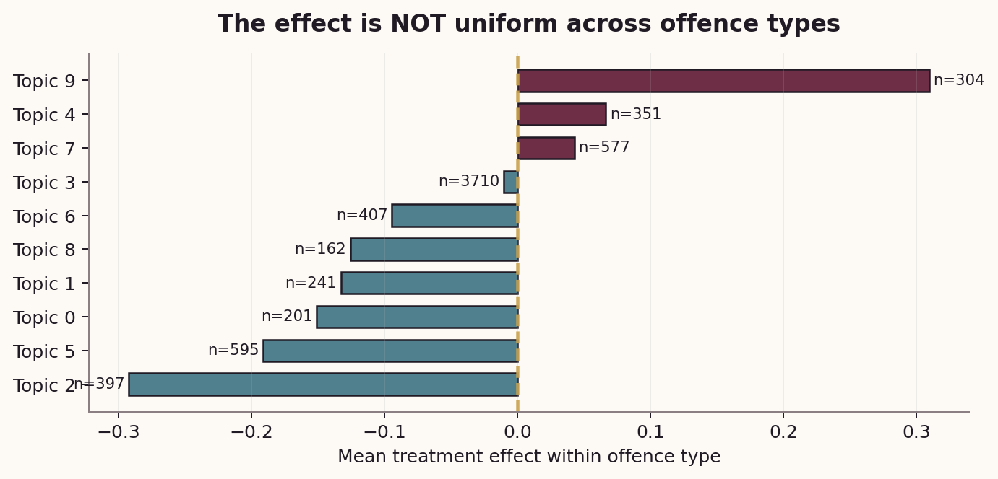
Q
Was the pattern the same for every crime?
The effect is not uniform
For some offence types the male-on-female effect is strongly harsher.
For others it is near zero.
The legal question is not “does it matter?”
but “in which offences does it matter, and by how much?”
The causal pattern is concentrated, not uniform. A small number of offence types account for most of the population-level
effect we saw in Step 8. This makes sense legally: 19th-century statutes imposed capital or transportation eligibility on a limited set of crimes (murder, rape, some aggravated assaults, infanticide). The male-on-female configuration cannot produce a capital sentence in an offence category where capital is not available, so any treatment effect on capital outcome must come from a narrow band of offence categories where the statute permits it. The heterogeneity plot visualises exactly that statutory structure.
Statute constrained the envelope. The male-on-female effect lives inside that envelope, and is strongest where discretion was widest.

Slide 9
What does this mean for criminal justice?
On proportionality
Offence type and evidence dominate sentencing outcomes — consistent with the statutory proportionality principle. Most of what we see is lawful, tariff-driven adjudication.
On the severe-band disparity
After adjustment, male-on-female cases were about 4 percentage points more likely to cross into hard-labour-or-worse territory than comparable cases. This is where disparate treatment lives.
On capital sentencing
The striking 7× raw capital-rate gap shrinks sharply after controlling for offence mix. A small but non-zero causal effect survives (AIPW +0.4 pp), concentrated in statutorily-eligible offences.

Slide 10
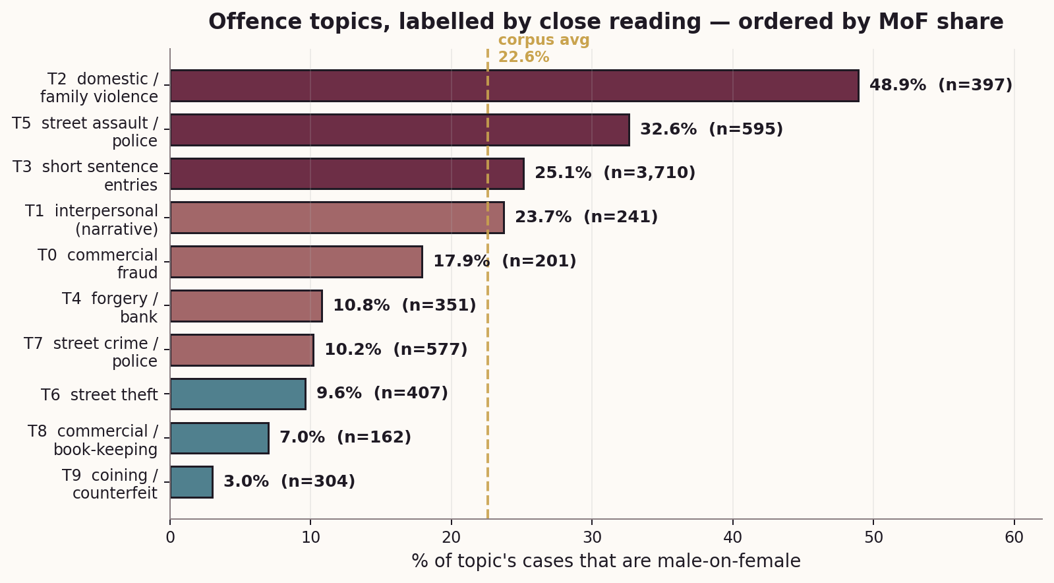
Do the statistics match the actual cases?
Q
The topics have real legal identities
Reading the vocabulary of each LDA topic gives us plain-English labels.
Topic 2 (“child, wife, house”) is 49% male-on-female — this is domestic / family violence.
Topic 9 (“coin, counterfeit”) is 3% MoF — coining and uttering counterfeit coin.
The heterogeneity plot isn’t abstract — it tracks the period’s offence structure.
The model’s heterogeneity recovers a real feature of Victorian sentencing law — not a statistical artefact.

Slide 11
What does the 7× capital gap mean?
Of the 75 capital verdicts:
A matched pair
50
TREATED (male-on-female):
Robert Earl — wilful murder of Margaret Pamphilon
→ capital sentence
CONTROL (nearly-identical propensity):
Herbert Madden — wilful murder of Herbert Patrick Madden
→ non-custodial
Match distance: 0.003 on the logit scale. Same offence topic. Different outcome.
were male-on-female (67%)
Reading every single one: nearly all are wilful murder indictments. The defendants killed a named female victim — usually a wife, partner, or relative.
Close reading validates direction. The effect is not abstract — it is wilful murder of women by male partners. Historically specific.
Does the model's "male-on-female cases get harsher sentences" finding mean the statistical algorithm is picking up a real legal pattern, or an artefact? In the capital band at least, close reading confirms it is real, concrete, and historically specific.

Slide 12
What we Learnt…
The three matched pairs show exactly the pattern the statistics imply — but they also show the limits of what matching can do.
The treated case in each pair is a wilful murder indictment against a female victim, ending in capital sentencing. The matched control — chosen by the algorithm because the case-level features are statistically similar — is in each case also an indictment for a serious crime (attempted murder, wilful murder of a male victim, or shooting with intent). But the controls received dramatically lighter sentences: non-custodial or institutional.
The honest caveat close reading forces us to make. These pairs are dramatic because we asked for cases where outcomes differed most. They are not representative of the average matched pair — most matched pairs have very similar outcomes. What the pairs illustrate is therefore the mechanism (where and how the effect operates) rather than its average magnitude.
Reading these pairs side-by-side is the closest an observational analysis can come to saying: for two cases with comparable evidence, narrative, and offence topic, the male-on-female configuration was associated with a categorically harsher outcome. A legal historian reading the three pairs above would recognise a pattern consistent with documented Victorian-era sentencing practices around lethal violence against women. But they would also, correctly, point out that the 1,500+ matched pairs where outcomes don’t differ are the ones that pull the average effect down to its modest +4.4 pp size.

Slide 13
Causal Findings
1. On average, male‑on‑female cases receive harsher sentences.
Even after holding offence type, evidence intensity, and narrative framing constant, the presence of a male defendant and female victim is causally associated with a small but statistically robust increase in sentence severity.
2. The most consequential effect is crossing the “severe band” (hard labour or capital).
Offence‑mix confounding had masked a real causal effect. Once comparable offences are compared, male‑on‑female cases are about 4.4 pp more likely to receive a sentence of hard labour or worse. This is the headline disparity: the threshold that distinguishes ordinary imprisonment from the harshest non‑capital punishments.
3. Capital sentencing is driven by offence type, not gender configuration.
The 7× raw capital-rate gap is mostly explained by offence-type differences. A residual effect of less than half a percentage point survives adjustment.

Slide 14
Three findings for legal history
01
The raw numbers were misleading
Male-on-female cases looked lighter on average, but that was driven by offence-mix differences. Once we compared like-with-like, the direction reversed.
02
The real finding: severe-band disparity
After adjustment, male-on-female cases were about 4 percentage points more likely to end in hard labour or worse. This is where judicial discretion showed its hand.
03
Capital sentencing: smaller than it looks
The 7× raw capital-rate gap is mostly explained by offence-type differences. A residual effect of less than half a percentage point survives adjustment.

Slide 15
WHAT WE TESTED
Limitation
Five independent methods agreed on direction
Covariate balance passed (|SMD| < 0.1)
Placebo treatment collapsed to zero
Random common cause left estimates unchanged
Data-subset refuter: estimates stable
Judge identity, priors, plea, counsel are all unobserved
LDA topics are noisy proxies for offence type
Only 75 capital sentences — small absolute counts
Cannot separate defendant vs victim effects
Findings do NOT transfer to modern sentencing
It does not say anything about modern sentencing. Different statutes, procedures, and discretion rules. Do not use as evidence about present-day courts.
It does not isolate the defendant's gender from the victim's gender. The treatment is an interaction — we cannot disentangle the two without stronger assumptions.
It does not mean every male-on-female case got harsher treatment. The effect is a population average, concentrated in a subset of offence categories.

Slide 16
Thank You!

